Slide 1
Modular Multi-ported SRAM-based Memories
Ameer M.S. Abdelhadi
Guy G.F. Lemieux

Slide 2
Multi-ported Memories:
A Keystone for Parallel Computation!
Enhance ILP for processors and accelerators, e.g.
  VLIW Processors
  CMPs
  Vector Processors
  CGRAs
DSPs
Major FPGA vendors provide dual-ported RAM only!
ASIC RAM compilers provide limited ports!

Slide 3
Multi-ported SRAM Cell
ASICs / custom design only!
Increasing ports incurs higher delays and area consumption

Slide 4
RAM Multi-pumping
Resources sharing
Low area
Performance degradation
Data dependencies

Slide 5
Multi-banking
Divide memory into smaller banks
Distribute data using fixed hashing scheme
Access to same bank is resolved by multiple request
The Pentium (P5) has 8-way two port interleaved cache*
Area efficient
Long arbitration delays
Variable access latency
*[Alpert & Avnon, IEEE Micro, June 1993]

Slide 6
Multi-read by Bank Replication
Example: Alpha 21264*
  Each integer cluster has a replicated 80-entry register file
  The 72-entry floating-point cluster register file is duplicated
  number of read ports is doubled
  Support two concurrent units each
*[Ditlow et al., IEEE ISSCC , Feb. 2011]

Slide 7
Register-based Multi-ported RAM
High performance for small caches (<1k lines)
High resources consumption for deep memories (scaling)
Infeasible on Altera’s high-end Stratix V with our smallest test-case!

Slide 8
LVT-based Approach
Stores the ID of latest written bank
LVT is a multi-ported RAM for banks IDs
  Implemented with registers
  Still has scaling issues: infeasible for deep memories!

Slide 9
LVT-based Multi-ported RAM Example (1)

Slide 10
LVT-based Multi-ported RAM Example (2)

Slide 11
LVT-based Multi-ported RAM Example (3)

Slide 12
XOR-based Multi-ported RAM*
SRAM-based
XOR is used to embed and extract data back:
Embed: DATA=OLD⊕NEW
Extract: DATA⊕OLD=OLD⊕NEW⊕OLD=NEW
*[Laforest et al. ACM/SIGDA FPGA, Feb. 2012]

Slide 13
XOR-based Multi-ported RAM Example (1)

Slide 14
XOR-based Multi-ported RAM Example (2)

Slide 15
XOR-based Multi-ported RAM Example (3)

Slide 16
XOR-based Multi-ported RAM Example (4)

Slide 17
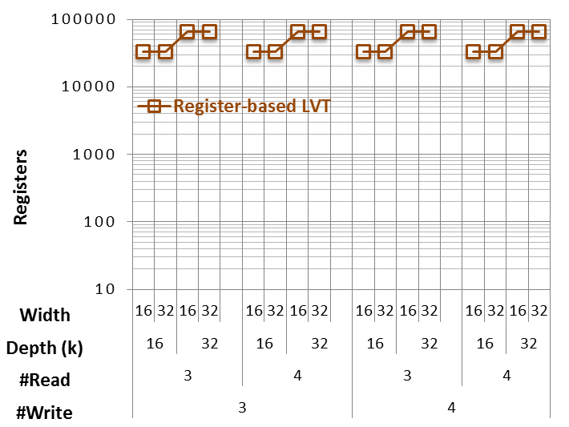
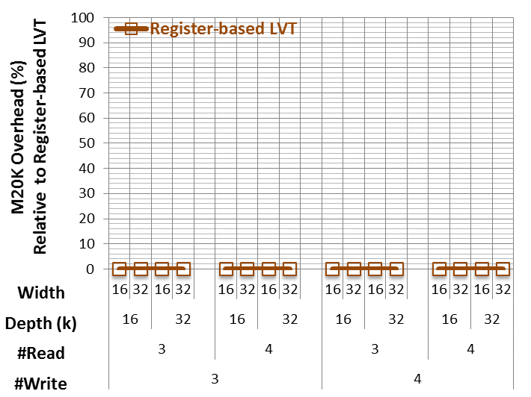
Motivation
 | #Registers | #BRAMs
Register-based LVT | ✗ | ✓
XOR-based | ✓ | ✗
Proposed I-LVT | ✓ | ✓

Slide 18
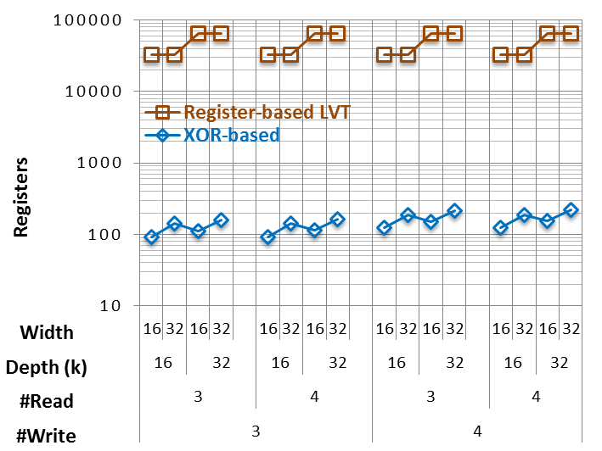
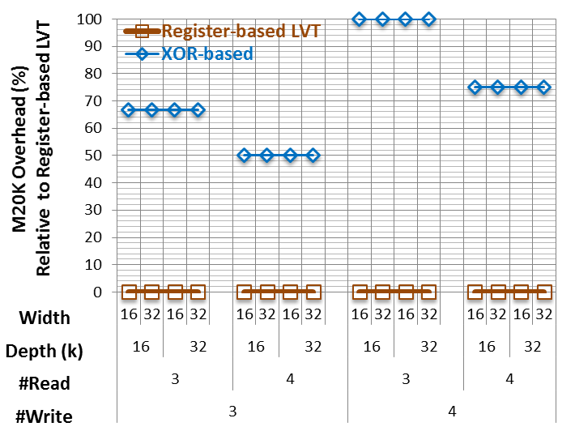
Motivation
 | #Registers | #BRAMs
Register-based LVT | ✗ | ✓
XOR-based | ✓ | ✗
Proposed I-LVT | ✓ | ✓

Slide 19
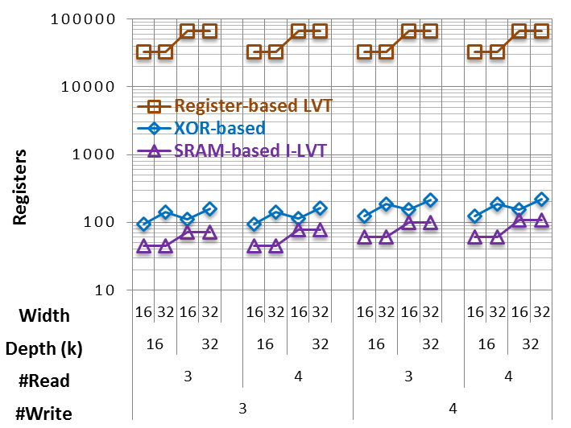
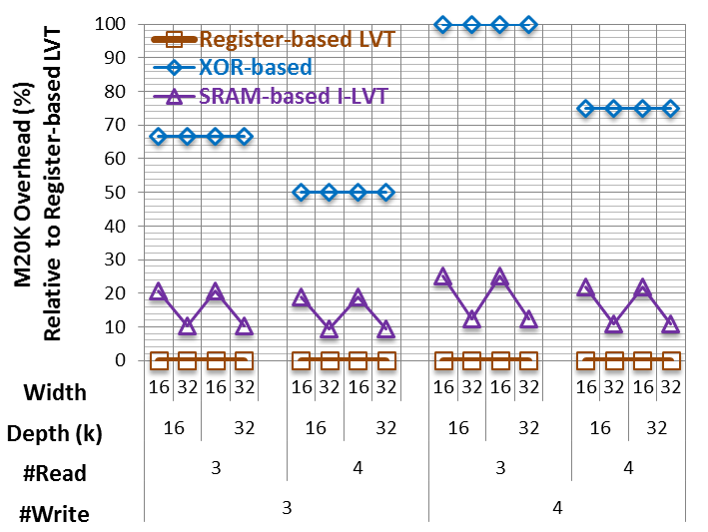
Motivation
 | #Registers | #BRAMs
Register-based LVT | ✗ | ✓
XOR-based | ✓ | ✗
Proposed I-LVT | ✓ | ✓

Slide 20
Method
Based on LVT approach
The LVT is a multi-ported RAM with constant inputs (bank IDs)
SRAM-based LVT
  Can be implemented with XOR-based multi-ported RAM
  Is generalized by the proposed I-LVT approach
  Two special cases are provided:
    Binary-coded I-LVT
    One-hot-coded I-LVT

Slide 21
Method
Based on LVT approach
The LVT is a multi-ported RAM with constant inputs (bank IDs)
SRAM-based LVT
  Can be implemented with XOR-based multi-ported RAM
  Is generalized by the proposed I-LVT approach
  Two special cases are provided:
    Binary-coded I-LVT
    One-hot-coded I-LVT

Slide 22
Method
Based on LVT approach
The LVT is a multi-ported RAM with constant inputs (bank IDs)
SRAM-based LVT
  Can be implemented with XOR-based multi-ported RAM
  Is generalized by the proposed I-LVT approach
  Two special cases are provided:
    Binary-coded I-LVT
    One-hot-coded I-LVT

Slide 23
Method
Based on LVT approach
The LVT is a multi-ported RAM with constant inputs (bank IDs)
SRAM-based LVT
  Can be implemented with XOR-based multi-ported RAM
  Is generalized by the proposed I-LVT approach
  Two special cases are provided:
    Binary-coded I-LVT
    One-hot-coded I-LVT

Slide 24
Method
Based on LVT approach
The LVT is a multi-ported RAM with constant inputs (bank IDs)
SRAM-based LVT
  Can be implemented with XOR-based multi-ported RAM
  Is generalized by the proposed I-LVT approach
  Two special cases are provided:
    Binary-coded I-LVT
    One-hot-coded I-LVT

Slide 25
Invalidation Table Approach (I-LVT)
A bank for each write
A single write to a specific bank invalidates all the other banks
Feedbacks are received from all other banks
f_{fb} generates a new data that contradicts all the other banks
f_{out} detects the non-contradicting bank ID

Slide 26
Invalidation Table Approach (I-LVT)
A bank for each write
A single write to a specific bank invalidates all the other banks
Feedbacks are received from all other banks
f_{fb} generates a new data that contradicts all the other banks
f_{out} detects the non-contradicting bank ID

Slide 27
Invalidation Table Approach (I-LVT)
A bank for each write
A single write to a specific bank invalidates all the other banks
Feedbacks are received from all other banks
f_{fb} generates a new data that contradicts all the other banks
f_{out} detects the uncontradicted bank ID

Slide 28
Invalidation Table Approach (I-LVT)
A bank for each write
A single write to a specific bank invalidates all the other banks
Feedbacks are received from all other banks
f_{fb} generates a new data that contradicts all the other banks
f_{out} detects the uncontradicted bank ID

Slide 29
Invalidation Table Approach (I-LVT)
A bank for each write
A single write to a specific bank invalidates all the other banks
Feedbacks are received from all other banks
f_{fb} generates a new data that contradicts all the other banks
f_{out} detects the uncontradicted bank ID

Slide 30
Bank ID Embedding: Binary-coded Bank Selectors
Feedback function for bank k:
Output function (all banks):

Slide 31
Mutual-exclusive Conditions: One-hot-coded Bank Selectors
Feedback function for bank k:
Output function (check if condition match):

Slide 32
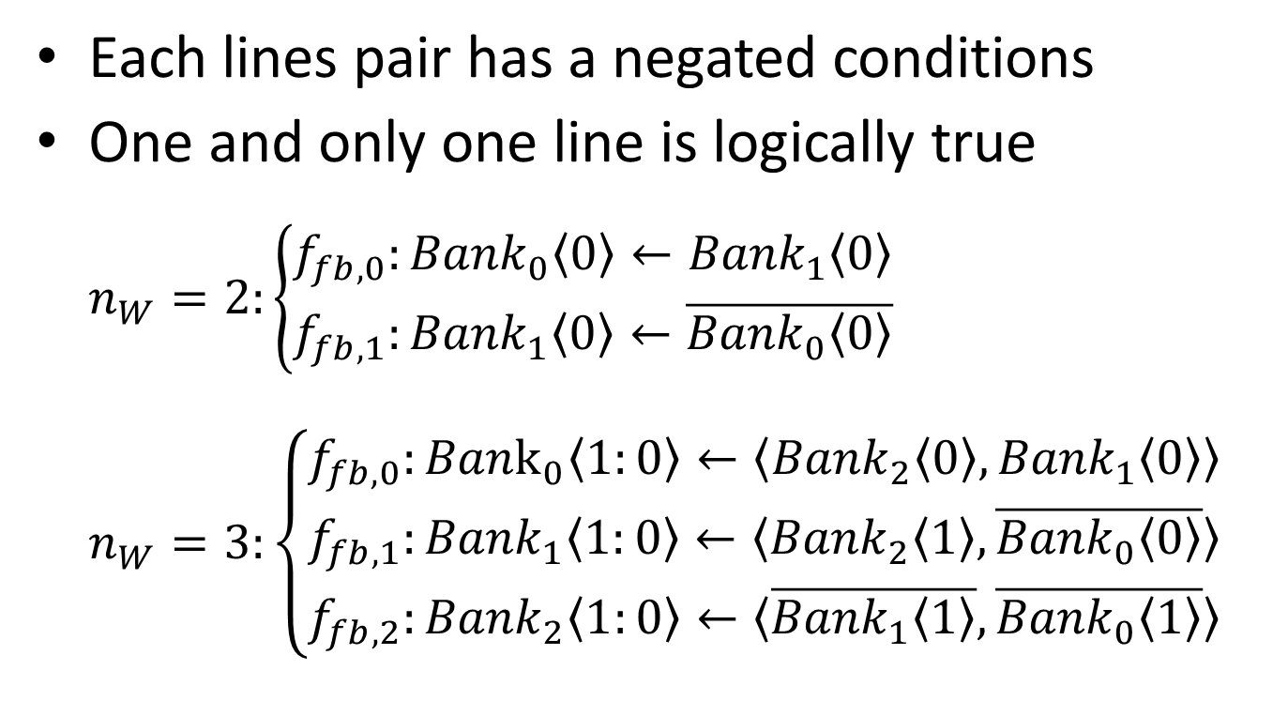
Mutual-exclusive Conditions Examples
Each lines pair has a negated conditions
One and only one line is logically true
$n_{W}=2:\left\{\begin{matrix}f_{fb,0}:{Bank}_{0}〈0〉←{Bank}_{1}〈0〉 \\ f_{fb,1}:{Bank}_{1}〈0〉←\overline{{Bank}_{0}〈0〉}\end{matrix}\right.$
$n_{W}=3:\left\{\begin{matrix}f_{fb,0}:{Bank}_{0}〈1:0〉←〈{Bank}_{2}〈0〉,{Bank}_{1}〈0〉〉 \\ f_{fb,1}:{Bank}_{1}〈1:0〉←〈{Bank}_{2}〈1〉,\overline{{Bank}_{0}〈0〉}〉 \\ f_{fb,2}:{Bank}_{2}〈1:0〉←〈\overline{{Bank}_{1}〈1〉},\overline{{Bank}_{0}〈1〉}〉\end{matrix}\right.$

Slide 33


One-hot/Binary Coded 2W/2R Example (1)
Condition:
$${Bank}_{0}={Bank}_{1}$$
Condition:
$${Bank}_{1}≠{Bank}_{0}$$

Slide 34
One-hot/Binary Coded 2W/2R Example (2)
Condition:
$${Bank}_{0}={Bank}_{1}$$
Condition:
$${Bank}_{1}≠{Bank}_{0}$$

Slide 35

One-hot/Binary Coded 2W/2R Example (3)
Condition:
$${Bank}_{0}={Bank}_{1}$$
Condition:
$${Bank}_{1}≠{Bank}_{0}$$

Slide 36
One-hot/Binary Coded 2W/2R Example (4)
Condition:
$${Bank}_{0}={Bank}_{1}$$
Condition:
$${Bank}_{1}≠{Bank}_{0}$$

Slide 37
3W/2R I-LVT Implementation
Binary-coded I-LVT
One-hot-coded I-LVT

Slide 38
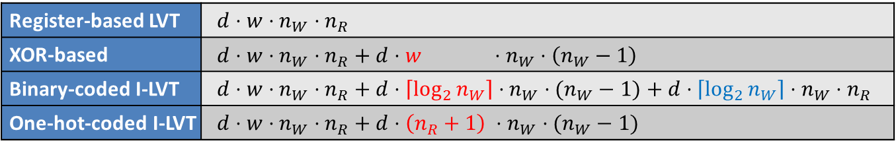
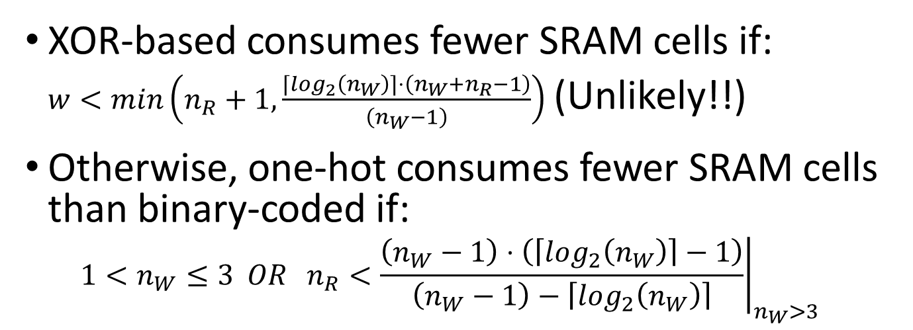
SRAM Consumption
Register-based LVT | $${d⋅w⋅n}_{W}⋅n_{R}$$
XOR-based | $$d⋅w⋅n_{W}⋅n_{R}+d⋅w ⋅n_{W}⋅\left(n_{W}−1\right)$$
Binary-coded I-LVT | $$d⋅w⋅n_{W}⋅n_{R}+d⋅\left\lceil \log_{2}{n_{W}}\right\rceil ⋅n_{W}⋅(n_{W}−1)+d⋅\left\lceil \log_{2}{n_{W}}\right\rceil ⋅n_{W}⋅n_{R}$$
One-hot-coded I-LVT | $$d⋅w⋅n_{W}⋅n_{R}+d⋅\left(n_{R}+1\right) ⋅n_{W}⋅(n_{W}−1)$$
XOR-based consumes fewer SRAM cells if:
$w<min\left(n_{R}+1,\frac{\left\lceil \log_{2}\left(n_{W}\right)\right\rceil ⋅\left({n_{W}+n}_{R}−1\right)}{\left(n_{W}−1\right)}\right)$ (Unlikely!!)
Otherwise, one-hot consumes fewer SRAM cells than binary-coded if:
${1<n}_{W}≤3 OR {\left.n_{R}<\frac{\left(n_{W}−1\right)⋅\left(\left\lceil \log_{2}\left(n_{W}\right)\right\rceil −1\right)}{\left(n_{W}−1\right)−\left\lceil \log_{2}\left(n_{W}\right)\right\rceil }\right|}_{n_{W}>3}$

Slide 39
Usage Guideline

Slide 40
Experimental Environment
Different ~1k designs have been synthesized with various parameters sweep
  Altera’s Quartus II with Altera’s Stratix V device
Verified with Altera’s ModelSim
  Over Million RAM cycles for each configuration
Bypassing capability:
  New data read-after-write (same as Altera’s M20K)
  New data read-during-write (same as a single register)
Parameterized Verilog and simulation/synthesis run-in-batch manager are available online:
https://code.google.com/p/multiported-ram/

Slide 41
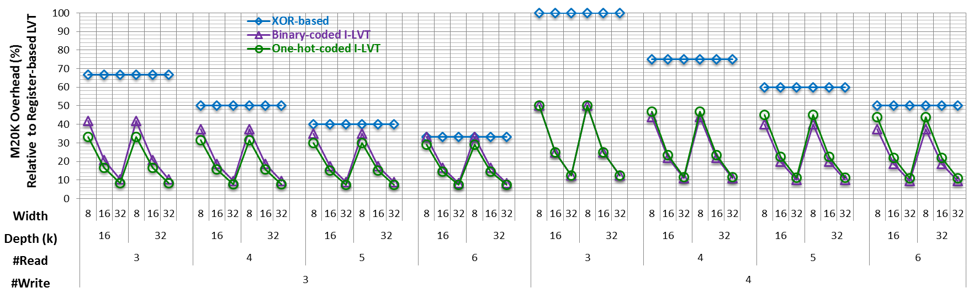
Experimental Results
BRAM Consumption
Compared to XOR-based approach:
  Average of 19%; up to 44% BRAM reduction
#BRAM compared to 32bit wide register-based LVT:
  Up to 200 % in XOR-based
  Up to 12.5% in I-LVT-based

Slide 42
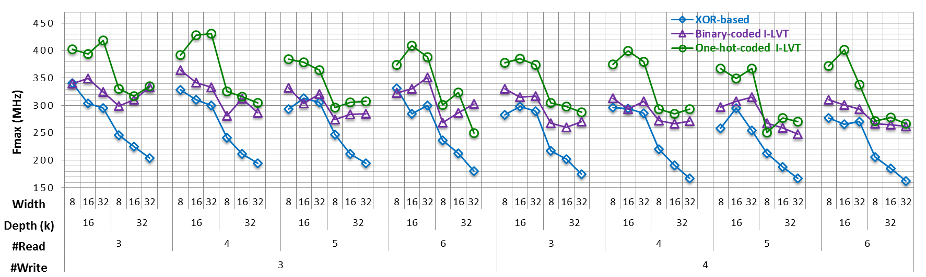
Experimental Results
Fmax
Compared to XOR-based approach:
  Average of 38%; up to 76% Fmax increase
One-hot-coded I-LVT exhibits the highest Fmax
  Due to fast feedback paths
  BRAM consumption still within 6% of the minimal

Slide 43
Conclusions
Modular multi-ported SRAM-based memories for embedded systems
Based on dual-ported BRAMs
Dramatically lower resources consumption and higher performance than previous approaches
  Close to register-based LVT BRAM consumption;
  No further significant improvement can be done
Additional features e.g. bypassing and initializing
Ready to use open source parameterized Verilog and a run-in-batch manager are available online
https://code.google.com/p/multiported-ram/

Slide 44


