Slide 1


Accelerated Approximate Nearest Neighbors Search Through Hierarchical Product Quantization
Ameer M.S. Abdelhadi
Dept. of Electrical & Computer Engineering
University of Toronto
Christos-Savvas Bouganis and George A. Constantinides
Dept. of Electrical & Electronic Engineering
Imperial College London

Slide 2
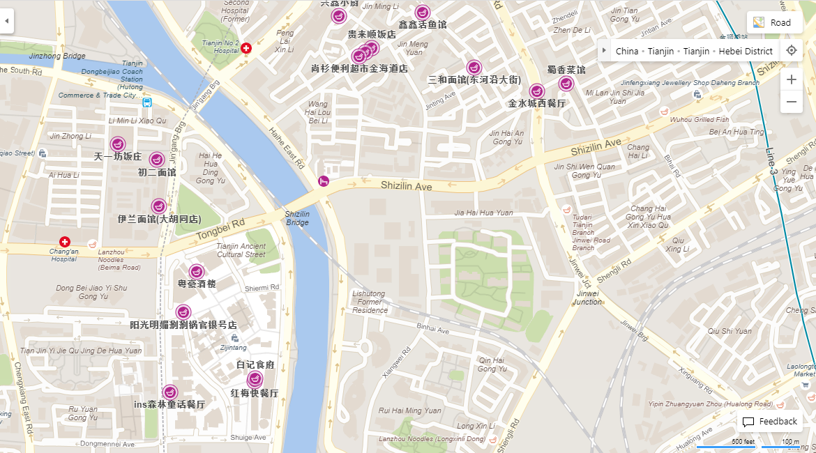
Nearest Neighbor Search
What's the nearest restaurant to my hotel?
- 2D space, Manhattan distance

Slide 3

Approximate
Nearest Neighbor Search
Find a restaurant whose distance to the hotel is at most $1+ε$ times the distance from the hotel to its nearest restaurant

Slide 4

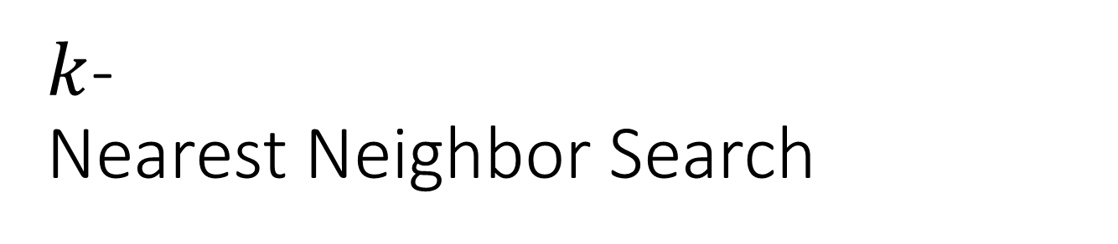
$k$-
Nearest Neighbor Search
Find the $k$ nearest restaurants to the hotel
- e.g. 8 nearest restaurants

Slide 5
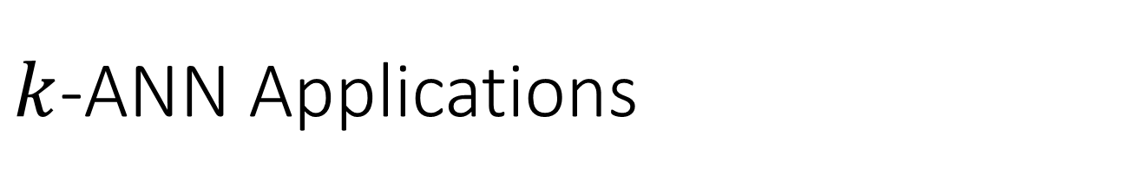
$k$-ANN Applications
Data compression
Databases and data mining
Information retrieval
Image and video databases
Machine learning
Pattern recognition
Statistics and data analysis
Recently: Memory-Augmented Neural Networks (Google DeepMind)

Slide 6
Memory-Augmented Neural Networks
DNNs with local memory (e.g. LSTM)
  Store the memory via weight adjustment
  Cannot store data over long time scale
  Incapable to efficiently solve complex structured tasks
Solution:
  Explicit external memory with differentiable attention
  Allows teaching using end-to-end backpropagation
Differentiable memory is compute- and memory-intensive, thus is not scalable!

Slide 7
Sparse
Memory-Augmented Neural Networks
A DNN with differentiable memory units is not scalable
The system does a lot of computations just to access a small chunk of memory
Heavy computational resources are needed to make this scale up
Scalability in training: unfolding the memory dramatically expands the network
Solution: sparse reads and writes based on k-ANN
  Online updates are not supported
  Storage and querying performance are not scalable

Slide 8
Approximate Nearest Neighbors (ANN) Search
Leading ANN methods:
  Space splitting metric trees:
  - branch-and-bound space partitioning, e.g.
  KD-trees, R-trees , K-D-B-tree, VP-trees…
  - Suffer from the “curse of dimensionality”!
  Hashes:
  - Hamming distance is used to approximate similarity
  - e.g. Locality sensitive hashes (LSH)
  Product quantization (PQ):
  - Quantizes several subspaces separately
Disadvantages:
  Software-optimized: hardware acceleration is not supported
  Memory-intensive: require intensive external memory access
  Static database: updates require reconstructing the data structure

Slide 9
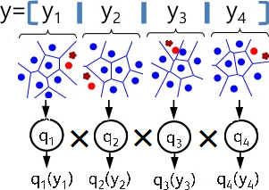
Product Quantization
Partitions space into a Cartesian
product of low-dimensional subspaces
Quantizes each partition into clusters
Data is regenerated from codebooks
Distance is approximated by summing
the distances from each subspace
Advantages:
  Dimension-wise scalability
  High accuracies
  Amendable to massively-parallel hardware acceleration on FPGAs
    1000’s × distributed memories (Block RAM) → distributed codebooks
    1000’s × DSPs → FP operations for distance calculation
  Amendable to support online updates
  Storage efficient: only quantized data need to be stored

Slide 10
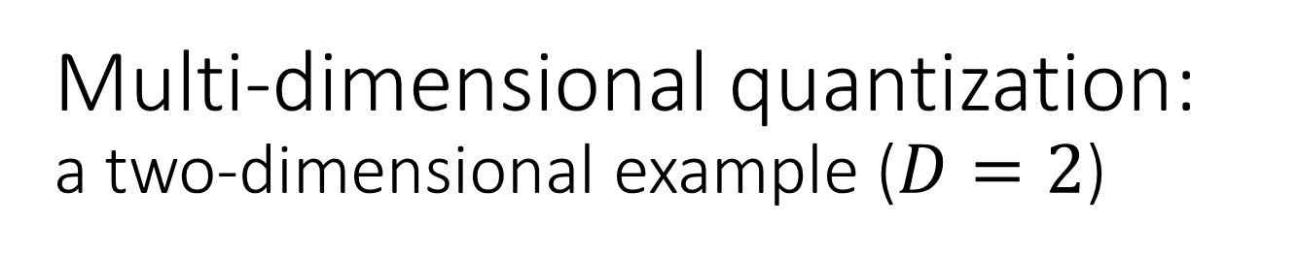
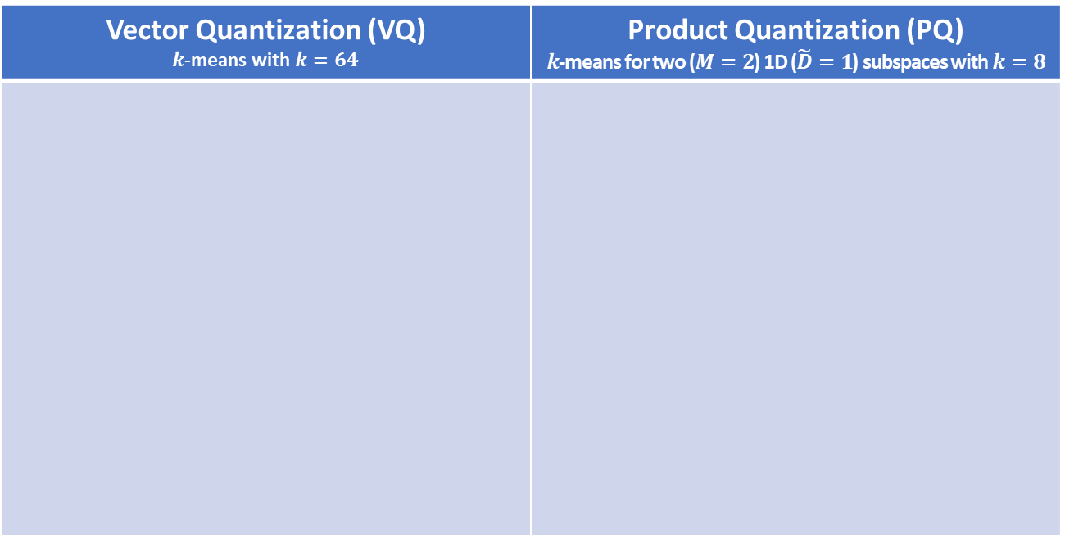
Multi-dimensional quantization: a two-dimensional example ($D=2$)
Vector Quantization (VQ) $k$-means with $k=64$ | Product Quantization (PQ) $k$-means for two ($M=2$) 1D ($\tilde{D}=1$) subspaces with $k=8$

Slide 11
Multi-dimensional quantization: a two-dimensional example ($D=2$)
Vector Quantization (VQ) $k$-means with $k=64$ | Product Quantization (PQ) $k$-means for two ($M=2$) 1D ($\tilde{D}=1$) subspaces with $k=8$

Slide 12
Hierarchical Product Quantization Key idea
Objectives:
Avoid exhaustive search
Enhance parallelism
Support online updates
Key idea:
Enhance PQ by using space partitioning techniques
Gradually refine search space with hierarchical search
VQ gradually subdivides the PQ search space
PQ is used to search within the refined subspace
×250 speedup compared to other OpenCL-FPGA & GPU methods

Slide 13
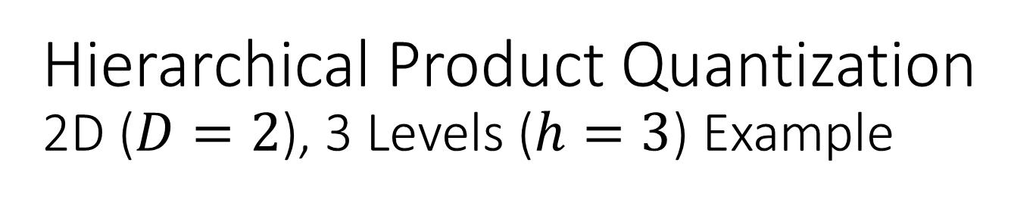
Hierarchical Product Quantization 2D ($D=2$), 3 Levels ($h=3$) Example

Slide 14
Hierarchical Product Quantization 2D ($D=2$), 3 Levels ($h=3$) Example

Slide 15
Hierarchical Product Quantization 2D ($D=2$), 3 Levels ($h=3$) Example

Slide 16
Hierarchical Product Quantization 2D ($D=2$), 3 Levels ($h=3$) Example

Slide 17
Hierarchical Product Quantization 2D ($D=2$), 3 Levels ($h=3$) Example

Slide 18
Hierarchical Product Quantization 2D ($D=2$), 3 Levels ($h=3$) Example

Slide 19
Hierarchical Product Quantization 2D ($D=2$), 3 Levels ($h=3$) Example

Slide 20
Hierarchical Product Quantization 2D ($D=2$), 3 Levels ($h=3$) Example

Slide 21
Hierarchical Product Quantization Querying through Voronoi Cells
VQ gradually subdivides the PQ search space
PQ is used to search within the refined subspace

Slide 22
The HPQ Data Structure:
A Recursive Definition
D-dim dataset
K-means for each sub-space
Meta-data: #points & distances
Encoded dataset
Vector quantization
Encoded dataset is stored within Voronoi cells

Slide 23
The HPQ Data Structure:
A Recursive Definition
D-dim dataset
K-means for each sub-space
Meta-data: #points & distances
Encoded dataset
Vector quantization
Encoded dataset is stored within Voronoi cells

Slide 24
The HPQ Data Structure:
A Recursive Definition
D-dim dataset
K-means for each sub-space
Meta-data: #points & distances
Encoded dataset
Vector quantization
Encoded dataset is stored within Voronoi cells

Slide 25
The HPQ Data Structure:
A Recursive Definition
D-dim dataset
K-means for each sub-space
Meta-data: #points & distances
Encoded dataset
Vector quantization
Encoded dataset is stored within Voronoi cells

Slide 26
The HPQ Data Structure:
A Recursive Definition
D-dim dataset
K-means for each sub-space
Meta-data: #points & distances
Encoded dataset
Vector quantization
Encoded dataset is stored within Voronoi cells

Slide 27
The HPQ Data Structure:
A Recursive Definition
D-dim dataset
K-means for each sub-space
Meta-data: #points & distances
Encoded dataset
Vector quantization
Encoded dataset is stored within Voronoi cells

Slide 28

Hardware architecture:
Layer-wise deep pipeline of refinement indices
Each Voronoi cell is distributed over multiple BRAMs
$M×\tilde{p}$ indices from each BRAM are read in parallel
Relevant distances of these indices are retrieved from codebooks
Squared sub-distances are accumulated to find total squared distance
Distances are compared to find the minimum
Distances in each code book are updated for each query (preprocessing)
$\hat{p}$ distances are processed in parallel

Slide 29

Hardware architecture:
Layer-wise deep pipeline of refinement indices
Each Voronoi cell is distributed over multiple BRAMs
$M×\tilde{p}$ indices from each BRAM are read in parallel
Relevant distances of these indices are retrieved from codebooks
Squared sub-distances are accumulated to find total squared distance
Distances are compared to find the minimum
Distances in each code book are updated for each query (preprocessing)
$\hat{p}$ distances are processed in parallel

Slide 30

Hardware architecture:
Layer-wise deep pipeline of refinement indices
Each Voronoi cell is distributed over multiple BRAMs
$M×\tilde{p}$ indices from each BRAM are read in parallel
Relevant distances of these indices are retrieved from codebooks
Squared sub-distances are accumulated to find total squared distance
Distances are compared to find the minimum
Distances in each code book are updated for each query (preprocessing)
$\hat{p}$ distances are processed in parallel

Slide 31
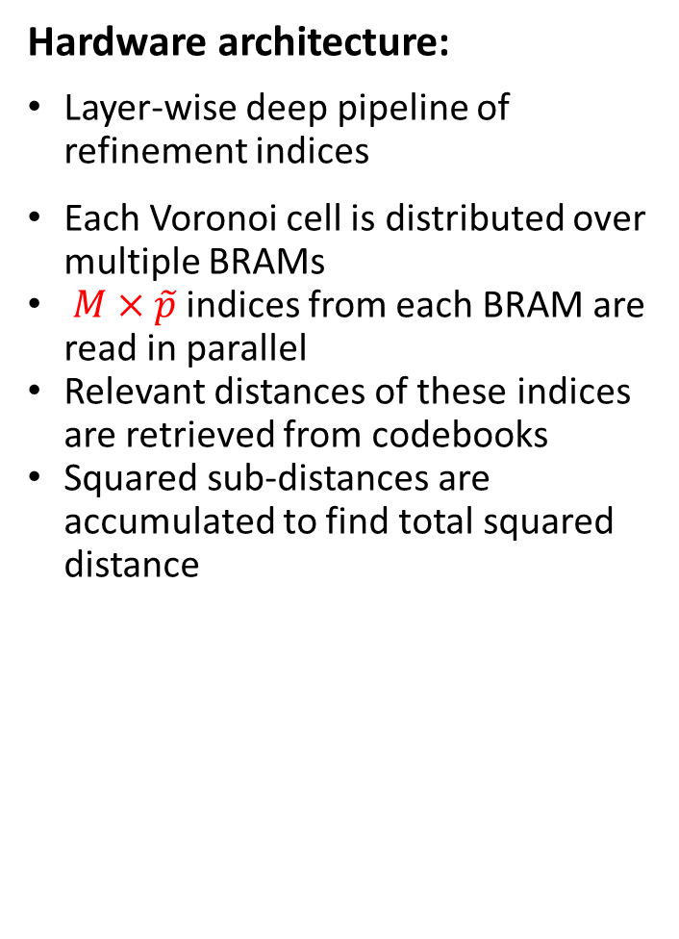
Hardware architecture:
Layer-wise deep pipeline of refinement indices
Each Voronoi cell is distributed over multiple BRAMs
$M×\tilde{p}$ indices from each BRAM are read in parallel
Relevant distances of these indices are retrieved from codebooks
Squared sub-distances are accumulated to find total squared distance
Distances are compared to find the minimum
Distances in each code book are updated for each query (preprocessing)
$\hat{p}$ distances are processed in parallel

Slide 32
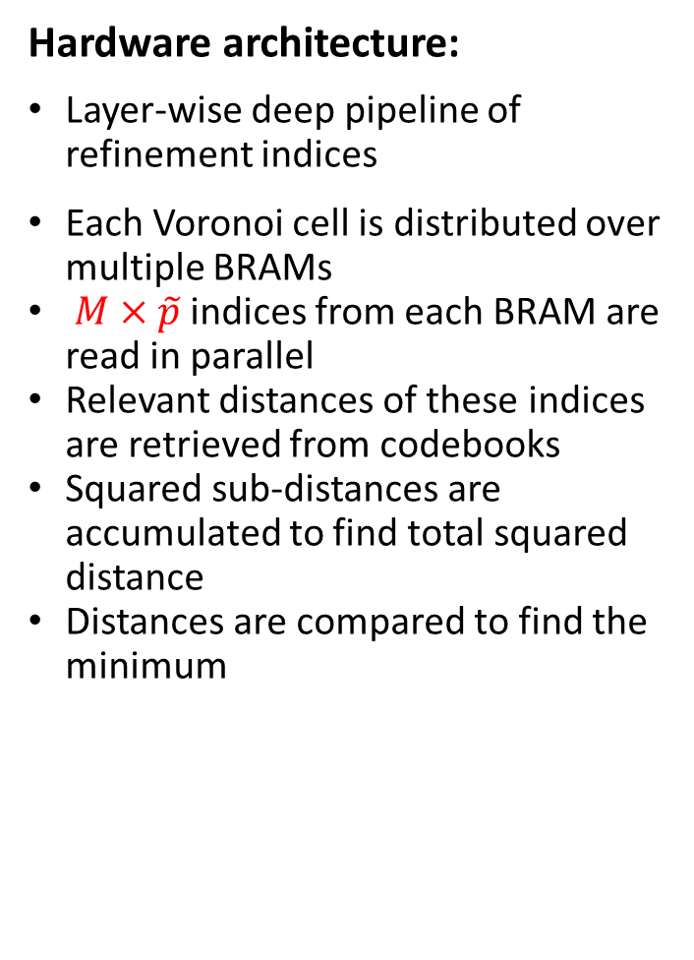
Hardware architecture:
Layer-wise deep pipeline of refinement indices
Each Voronoi cell is distributed over multiple BRAMs
$M×\tilde{p}$ indices from each BRAM are read in parallel
Relevant distances of these indices are retrieved from codebooks
Squared sub-distances are accumulated to find total squared distance
Distances are compared to find the minimum
Distances in each code book are updated for each query (preprocessing)
$\hat{p}$ distances are processed in parallel

Slide 33
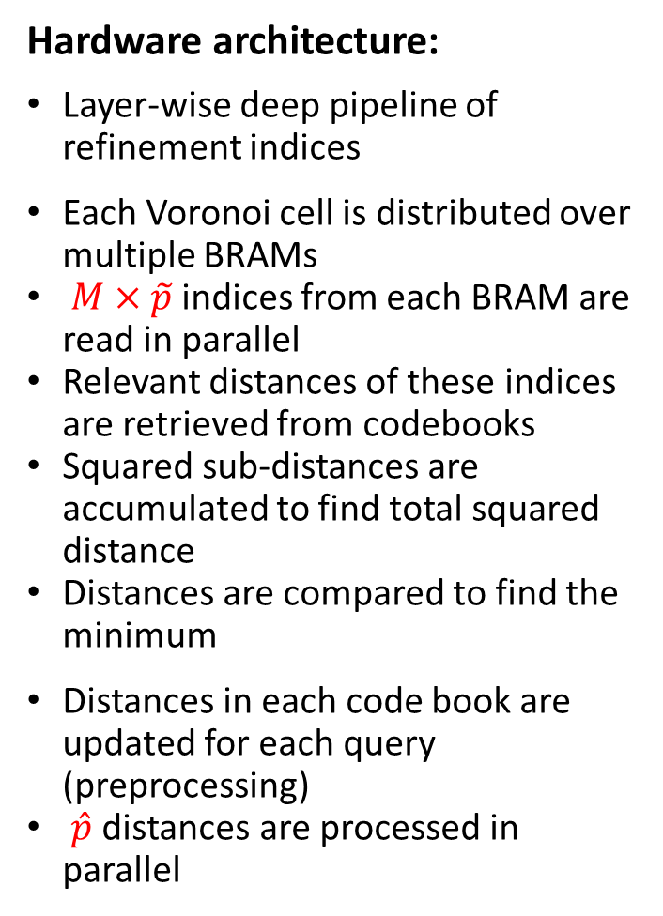
Hardware architecture:
Layer-wise deep pipeline of refinement indices
Each Voronoi cell is distributed over multiple BRAMs
$M×\tilde{p}$ indices from each BRAM are read in parallel
Relevant distances of these indices are retrieved from codebooks
Squared sub-distances are accumulated to find total squared distance
Distances are compared to find the minimum
Distances in each code book are updated for each query (preprocessing)
$\hat{p}$ distances are processed in parallel

Slide 34
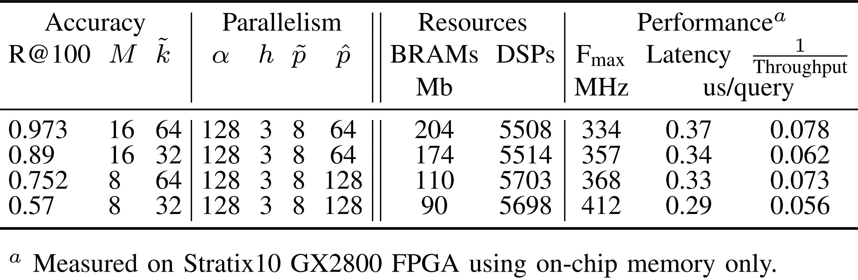
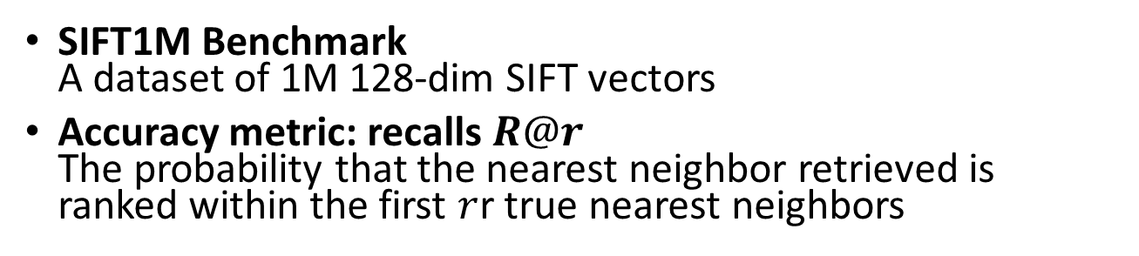
Experimental Results:
Accuracy Trade-offs
SIFT1M Benchmark
A dataset of 1M 128-dim SIFT vectors
Accuracy metric: recalls $R@r$
The probability that the nearest neighbor retrieved is ranked within the first $r$r true nearest neighbors

Slide 35
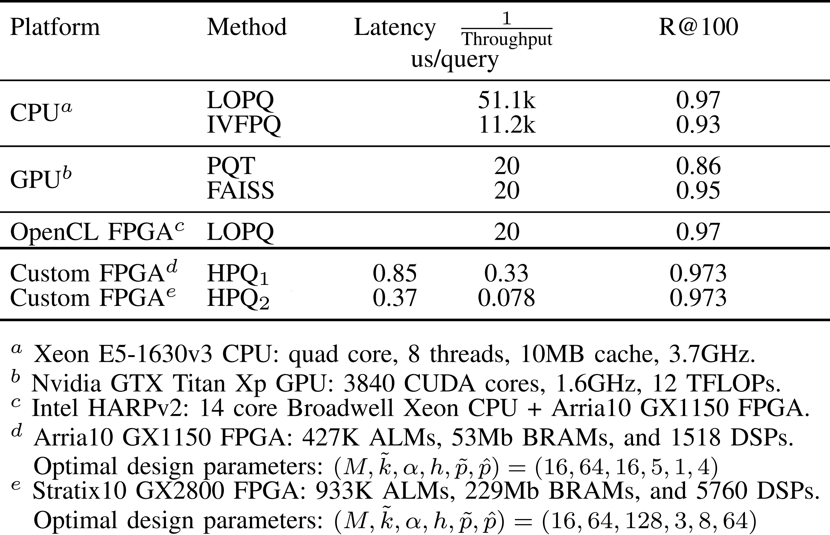
Experimental Results:
Comparison of Performance and Accuracy
×250 speedup compared to other OpenCL-FPGA & GPU methods

Slide 36
Future Work
Hierarchical Product Quantization with online updates
Integration with memory-augmented neural networks

Slide 37
Thank You!

